Slide 1




Notes:
*

Slide 2


UI ENGINEERING STUDIO
UI Engineering Studio. Day 2 Bootcamp: HTML

Slide 3

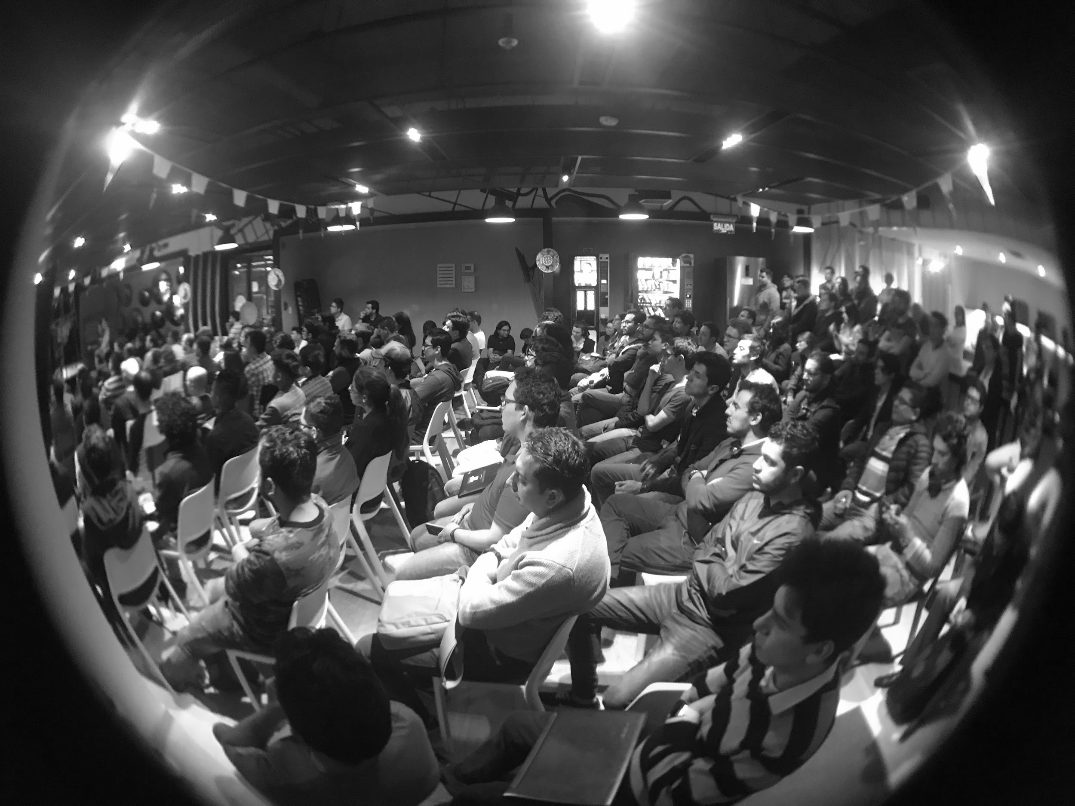
UI ENGINEERING STUDIO
HyperText Markup Language
HTML provides a means to create structured documents by denoting structural semantics for text such as headings, paragraphs, lists, links, quotes and other items
Semantic HTML
Accessibility
Homework

Slide 4
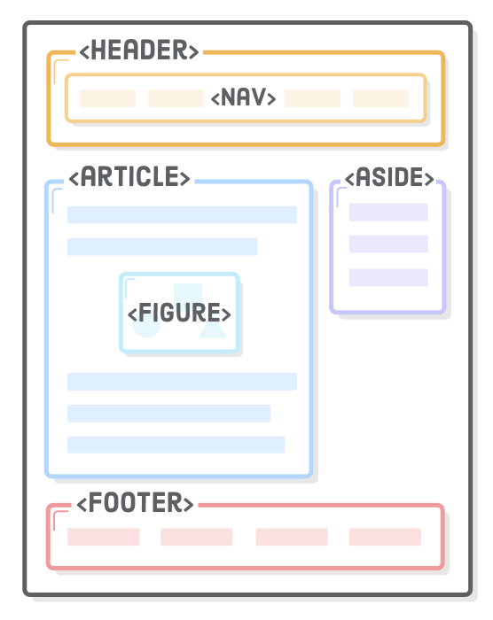
UI ENGINEERING STUDIO
UI Boot Camp: HTML Semantic HTML
Notes:
Source: https://internetingishard.com/html-and-css/semantic-html, https://a11yproject.com/, https://developer.mozilla.org/en-US/docs/Web/Accessibility/ARIA, https://htmlreference.io/

Slide 5
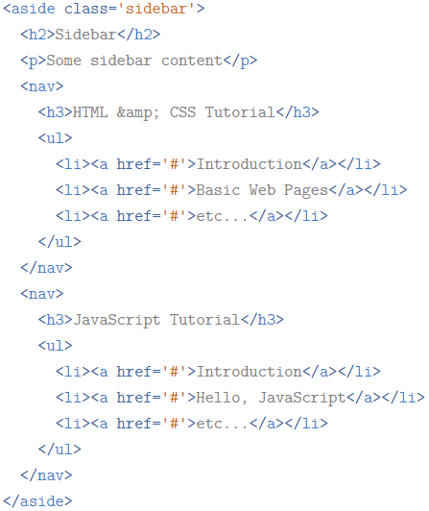
UI ENGINEERING STUDIO
UI Boot Camp: Semantic HTML
Notes:
Source: https://internetingishard.com/html-and-css/semantic-html, https://a11yproject.com/, https://developer.mozilla.org/en-US/docs/Web/Accessibility/ARIA, https://htmlreference.io/

Slide 6
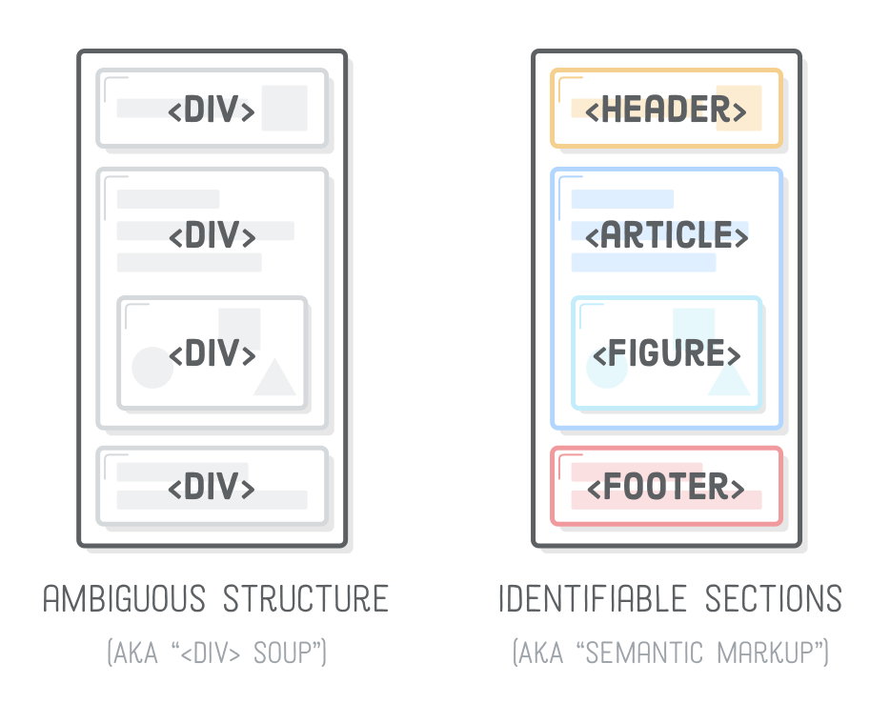
UI ENGINEERING STUDIO
UI Boot Camp: Semantic HTML
Notes:
Source: https://medium.freecodecamp.org/css-box-model-explained-by-living-in-a-boring-suburban-neighborhood-9a9e692773c1

Slide 7
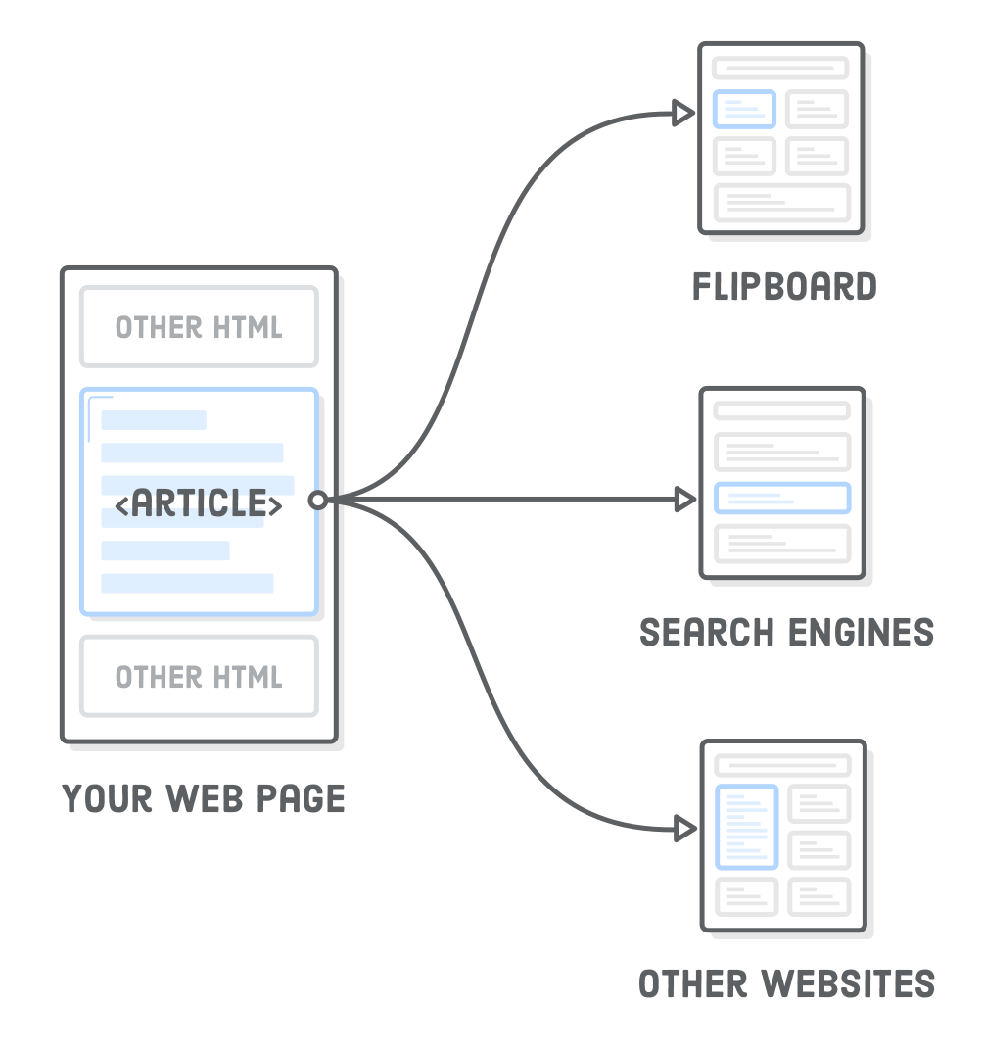
UI ENGINEERING STUDIO
UI Boot Camp: Semantic HTML Article
Represents an independent article in a web page. It should only wrap content that can be plucked out of your page and distributed in a completely different context
There could be more than one <article /> tags
Notes:
https://internetingishard.com/html-and-css/semantic-html, https://a11yproject.com/, https://developer.mozilla.org/en-US/docs/Web/Accessibility/ARIA, https://htmlreference.io/

Slide 8
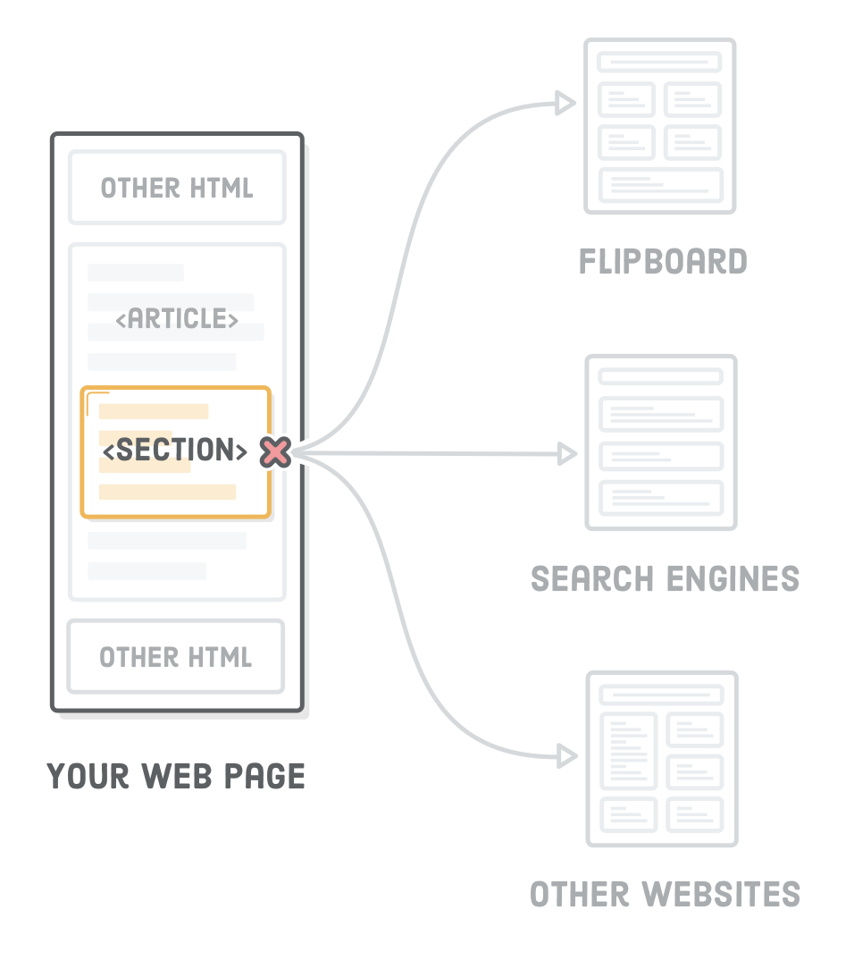
UI ENGINEERING STUDIO
UI Boot Camp: Semantic HTML Section
Sort of like an <article /> tag but the content does not have to make any sense outside the context of the document
Notes:
https://internetingishard.com/html-and-css/semantic-html, https://a11yproject.com/, https://developer.mozilla.org/en-US/docs/Web/Accessibility/ARIA, https://htmlreference.io/

Slide 9
UI ENGINEERING STUDIO
UI Boot Camp: Semantic HTML Section
<section> element shouldn’t be used to manipulate the document outline because browsers, screen readers, and some search engines don’t properly interpret the effect of <section> on the document outline. Instead, always define a page’s outline via heading levels, using <section> only as a replacement for container <div>’s when appropriate.
Notes:
Source: https://internetingishard.com/html-and-css/semantic-html, https://a11yproject.com/, https://developer.mozilla.org/en-US/docs/Web/Accessibility/ARIA, https://htmlreference.io/

Slide 10
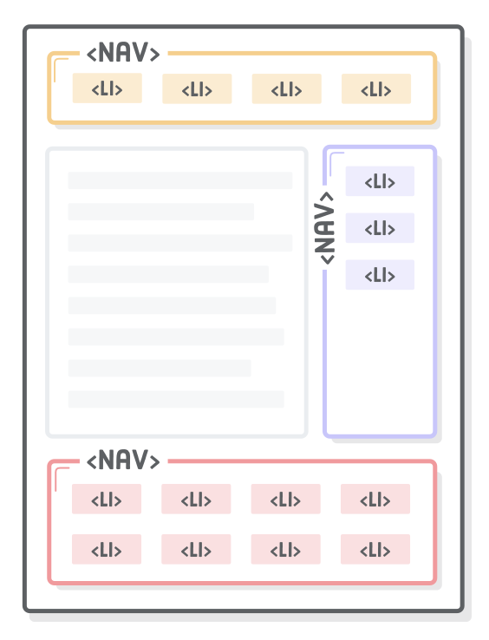
UI ENGINEERING STUDIO
UI Boot Camp: Semantic HTML Nav
Nav helps search engines to identify the structure of the entire website, making it easier to discover other pages
Notes:
Source: https://medium.freecodecamp.org/css-box-model-explained-by-living-in-a-boring-suburban-neighborhood-9a9e692773c1

Slide 11
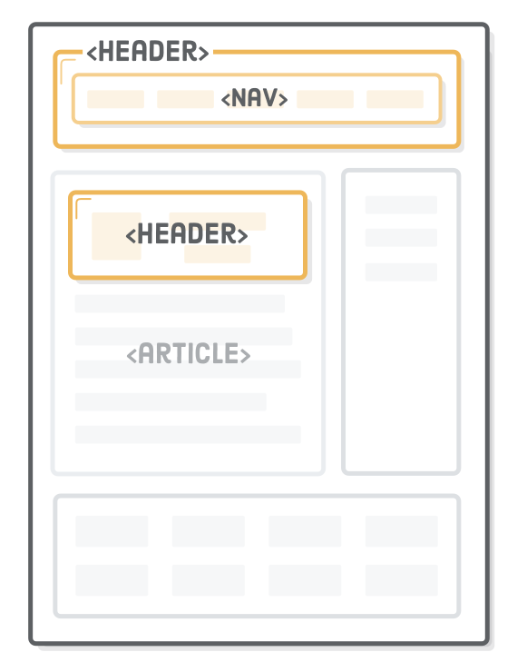
UI ENGINEERING STUDIO
UI Boot Camp: Semantic HTML Header
Introductory content for a section, article, or entire web page. It can be anything from your company’s logo to navigational aids or author information
Notes:
Source: https://medium.freecodecamp.org/css-box-model-explained-by-living-in-a-boring-suburban-neighborhood-9a9e692773c1

Slide 12
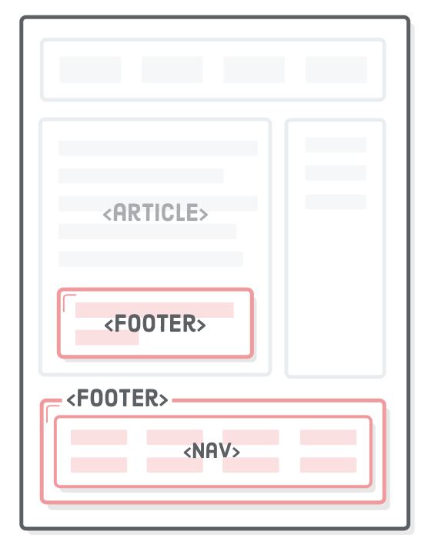
UI ENGINEERING STUDIO
UI Boot Camp: Semantic HTML Footer
Common use cases include things like copyright notices, footer navigation, and author bios at the end of blog posts
Notes:
Source: https://medium.freecodecamp.org/css-box-model-explained-by-living-in-a-boring-suburban-neighborhood-9a9e692773c1

Slide 13
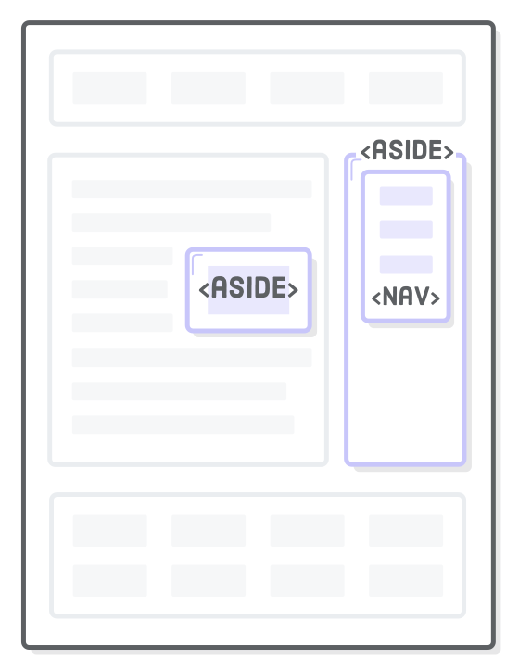
UI ENGINEERING STUDIO
UI Boot Camp: Semantic HTML Aside
Content that is not related with the main topic of the page, article or section where it is located
Common use cases are sidebars and advertisement
Notes:
Source: https://medium.freecodecamp.org/css-box-model-explained-by-living-in-a-boring-suburban-neighborhood-9a9e692773c1

Slide 14
UI ENGINEERING STUDIO
UI Boot Camp: Semantic HTML
Don’t use HTML5 new semantic elements just for the sake of using them
Notes:
Source: https://medium.freecodecamp.org/css-box-model-explained-by-living-in-a-boring-suburban-neighborhood-9a9e692773c1

Slide 15
UI ENGINEERING STUDIO
UI Boot Camp: Accessibility Web accessibility for designers
Have all the content fitting a logical heading structure
Consider the reading order
Provide good contrast
Use true text instead of image text
Watch the use of CAPS
Use adequate font size
Use animation, Video and Audio carefully
https://webaim.org/resources/designers/
Notes:
Source: https://medium.freecodecamp.org/css-box-model-explained-by-living-in-a-boring-suburban-neighborhood-9a9e692773c1

Slide 16
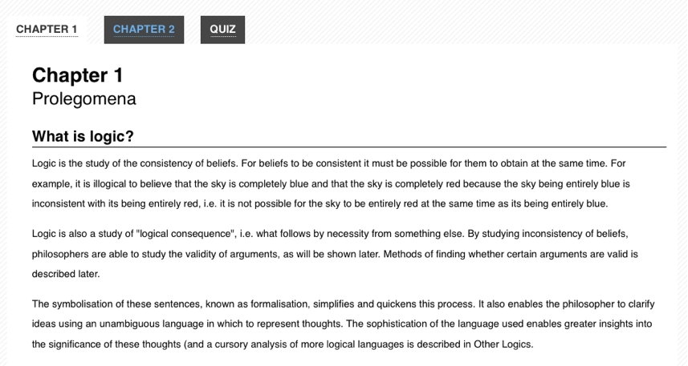
UI ENGINEERING STUDIO
UI Boot Camp: Accessibility
Notes:
Source: https://medium.freecodecamp.org/css-box-model-explained-by-living-in-a-boring-suburban-neighborhood-9a9e692773c1

Slide 17
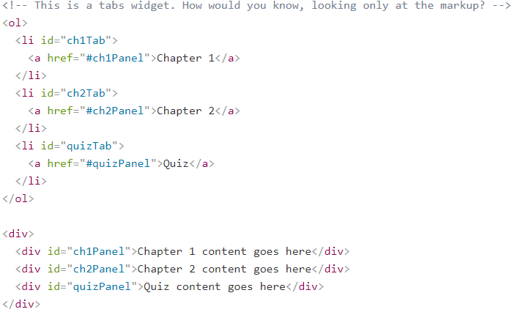
UI ENGINEERING STUDIO
UI Boot Camp: Accessibility
Notes:
Source: https://medium.freecodecamp.org/css-box-model-explained-by-living-in-a-boring-suburban-neighborhood-9a9e692773c1

Slide 18
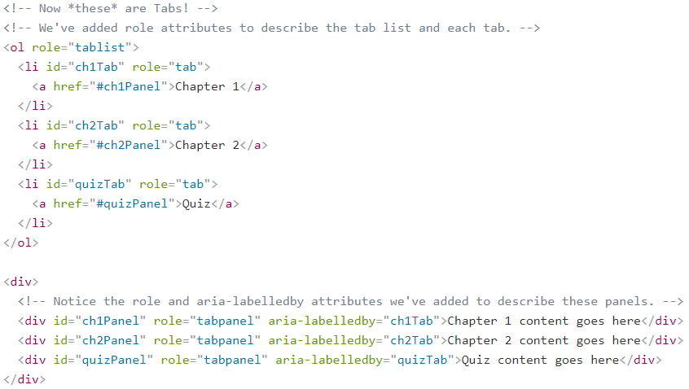
UI ENGINEERING STUDIO
UI Boot Camp: Accessibility
UI Boot Camp: Aria
Notes:
Source: https://medium.freecodecamp.org/css-box-model-explained-by-living-in-a-boring-suburban-neighborhood-9a9e692773c1

Slide 19
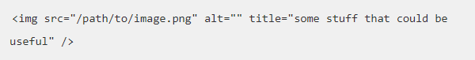
UI ENGINEERING STUDIO
UI Boot Camp: Accessibility
UI Boot Camp: Multiple accessibility attributes
When multiple accessibility attributes are provided, there are selection criterias based on the attribute values. In example, for the <img> tag consider the following list, where the higher the attribute is, the higher it is its value
aria-labelledby
aria-label
alt
title
Notes:
Source: https://medium.freecodecamp.org/css-box-model-explained-by-living-in-a-boring-suburban-neighborhood-9a9e692773c1

Slide 20

UI ENGINEERING STUDIO
UI Boot Camp: HTML Homework: Magazine Cover

Slide 21
UI ENGINEERING STUDIO
UI Boot Camp: HTML HTML A11Y Form
Develop in HTML a form with WCAG AA standard.
Form:
Should have at least 7 inputs.
Should have at least 3 types of inputs.
Should have at least 3 required fields.
Is not a functional form (no Ajax or js validation)
JS and CSS is not need it.

Slide 22
Notes:
*

